Slide 1
Chapter 8 Operator Overloading
Notes:
What is operator overloading in C++ with simple example?
The meaning of an operator is always same for variable of basic types like: int, float, double etc. For example: To add two integers, + operator is used. ... This feature in C++ programming that allows programmer to redefine the meaning of an operator (when they operate on class objects) is known as operator overloading.

Slide 2
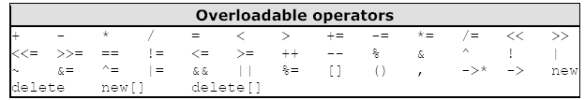
Operator Overloading
Operator overloading is one of the most exciting features of object-oriented programming
For example, statements like
d3.addobjects(d1, d2); OR
d3=d1.addobjects(d2);
can be changed to the much more readable
d3 = d1 + d2;
Here is a list of all the operators that can be overloaded:

Slide 3
Operator Overloading Cont’d
the opportunity to redefine the C++ language
to create new definitions for operators
Using the operator Keyword followed by the operator sign that we want to overload.
data type conversion, is closely connected with operator overloading
Overloading Unary Operators
Overloading Binary Operators

Slide 4
Overloading Unary Operators
Unary operators acts on only one operand.
unary operators are the increment and decrement operators ++ and - -.
c1.inc_count(); // by calling function inc_count()
++c1; // by using increment operator ++
Class ‘s instance

Slide 5
Overloading Unary Operators - Example
// Page 321
// countpp1.cpp
// increment counter variable
with ++ operator(prefix)
#include <iostream.h>
class Counter
{
private:
unsigned int count;
public:
Counter() : count(0)
{ }
unsigned int get_count()
{ return count; }
void operator ++ ()
{
++count;
}
};
int main()
{
Counter c1, c2;
cout << “\nc1=” << c1.get_count();
cout << “\nc2=” << c2.get_count();
++c1;
++c2;
++c2;
cout << “\nc1=” << c1.get_count();
cout << “\nc2=” << c2.get_count() << endl;
return 0;
}

Slide 6
Overloading Unary Operators – Example
// Page 324
// countpp2.cpp
// increment counter variable
with ++ operator, return value
#include <iostream.h>
class Counter
{
private:
unsigned int count;
public:
Counter() : count(0)
{ }
unsigned int get_count()
{ return count; }
Counter operator ++ ()
{
++count;
Counter temp;
temp.count = count;
return temp;
}
};
int main()
{
Counter c1, c2; //c1=0, c2=0
cout << “\nc1=” << c1.get_count();
cout << “\nc2=” << c2.get_count();
++c1; //c1=1
c2 = ++c1; //c1=2, c2=2
cout << “\nc1=” << c1.get_count();
cout << “\nc2=” << c2.get_count() << endl;
return 0;
}

Slide 7
Overloading Unary Operators – Example
// Page 325
// countpp3.cpp
// increment counter variable
with ++ operator
// uses unnamed temporary object
#include <iostream.h>
class Counter
{
private:
unsigned int count;
public:
Counter() : count(0)
{ }
Counter(int c) : count(c)
{ }
unsigned int get_count()
{
return count;
}
Counter operator ++ ()
{
++count; // increment count, then return
return Counter(count); // an unnamed temporary //object initialized to this count
}
};
int main()
{
Counter c1, c2; //c1=0, c2=0
cout << “\nc1=” << c1.get_count();
cout << “\nc2=” << c2.get_count();
++c1; //c1=1
c2 = ++c1; //c1=2, c2=2
cout << “\nc1=” << c1.get_count();
cout << “\nc2=” << c2.get_count() << endl;
return 0;
}

Slide 8
Overloading Unary Operators – Example
//Page 327
// postfix.cpp
// overloaded ++ operator in both prefix and postfix
#include <iostream.h>
class Counter
{
private:
unsigned int count;
public:
Counter() : count(0)
{ }
Counter(int c) : count(c)
{ }
unsigned int get_count() const
{ return count; }
Counter operator ++ () //increment
{ count (prefix)
return Counter(++count);
}
Counter operator ++ (int) //increment count (postfix)
{
return Counter(count++);
}
};
int main()
{
Counter c1, c2; //c1=0, c2=0
cout << “\nc1=” << c1.get_count();
cout << “\nc2=” << c2.get_count();
++c1; //c1=1
c2 = ++c1; //c1=2, c2=2 (prefix)
cout << “\nc1=” << c1.get_count();
cout << “\nc2=” << c2.get_count();
c2 = c1++; //c1=3, c2=2 (postfix)
cout << “\nc1=” << c1.get_count();
cout << “\nc2=” << c2.get_count() << endl;
return 0;
}
Notes:
for prefix notation, is
Counter operator ++ ()
for postfix notation, is
Counter operator ++ (int)
Counter operator ++ ()
{ return Counter(++count);
}
Counter operator ++ (int) //increment count (postfix)
{ return Counter(count++);
}

Slide 9
Overloading Binary Operators
Binary operators can be overloaded just as easily as unary operators
Overload arithmetic operators, comparison operators, and arithmetic assignment operators
In the operator + () function, the left operand is accessed directly—since this is the object of which the operator is a member—using feet and inches.
The right operand is accessed as the function’s argument, as d2.feet and d2.inches.

Slide 10
Overloading Binary Operators – Example
//Page 329
// englplus.cpp
// overloaded ‘+’ operator adds two Distances
#include <iostream>
class Distance
{
private:
int feet;
float inches;
public:
Distance() : feet(0),inches(0.0){ }
Distance(int ft, float in) :feet(ft),inches(in)
{ }
void getdist()
{cout << “\nEnter feet: “; cin >> feet;
cout << “Enter inches: “; cin >> inches;}
void showdist() const
{ cout << feet << “\’-” << inches << ‘\”’;}
Distance operator + ( Distance );
};
Distance Distance::operator + (Distance d2)
{ int f = feet + d2.feet;
float i = inches + d2.inches;
if(i >= 12.0)
{i -= 12.0;
f++;
} //return a temporary Distance
return Distance(f,i); //initialized to sum
}
int main()
{
Distance dist1, dist3, dist4;
dist1.getdist();
Distance dist2(11, 6.25);
dist3 = dist1 + dist2; //single ‘+’ operator
dist4 = dist1 + dist2 + dist3; //multiple ‘+’ operators
cout << “dist1 = “; dist1.showdist(); cout << endl;
cout << “dist2 = “; dist2.showdist(); cout << endl;
cout << “dist3 = “; dist3.showdist(); cout << endl;
cout << “dist4 = “; dist4.showdist(); cout << endl;
return 0;
}
Notes:
for prefix notation, is
Counter operator ++ ()
for postfix notation, is
Counter operator ++ (int)
Counter operator ++ ()
{ return Counter(++count);
}
Counter operator ++ (int) //increment count (postfix)
{ return Counter(count++);
}

Slide 11
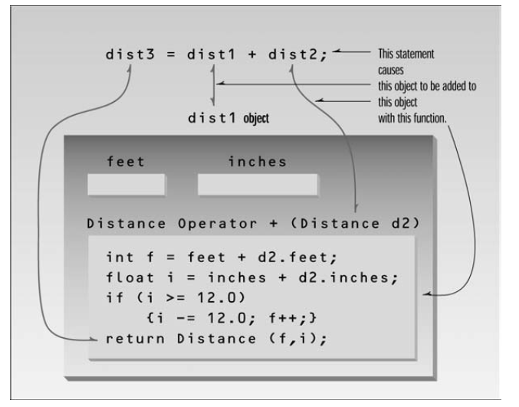

Slide 12
Overloading Binary Operators – Example
Comparison Operators
// engless.cpp
// overloaded ‘<’ operator compares two Distances
#include <iostream>
using namespace std;
class Distance //English Distance class
{private:
int feet;
float inches;
public: //constructor (no args)
Distance() : feet(0), inches(0.0)
{ } //constructor (two args)
Distance(int ft, float in) : feet(ft), inches(in)
{ }
void getdist() //get length from user
{cout << “\nEnter feet: “; cin >> feet;
cout << “Enter inches: “; cin >> inches;}
void showdist() const //display distance
{ cout << feet << “\’-” << inches << ‘\”’; }
bool operator < (Distance);
};
//compare this distance with d2
bool Distance::operator < (Distance d2)
{
float bf1 = feet + inches/12;
float bf2 = d2.feet + d2.inches/12;
return (bf1 < bf2) ? true : false;
}
int main()
{
Distance dist1; //define Distance dist1
dist1.getdist(); //get dist1 from user
Distance dist2(6, 2.5);
cout << “\ndist1 = “; dist1.showdist();
cout << “\ndist2 = “; dist2.showdist();
if( dist1 < dist2 ) //overloaded ‘<’ operator
cout << “\ndist1 is less than dist2”;
else
cout << “\ndist1 is greater than (or equal to) dist2”;
cout << endl;
return 0;
}
Notes:
for prefix notation, is
Counter operator ++ ()
for postfix notation, is
Counter operator ++ (int)
Counter operator ++ ()
{ return Counter(++count);
}
Counter operator ++ (int) //increment count (postfix)
{ return Counter(count++);
}

Slide 13
Overloading Binary Operators – Example
Arithmetic Assignment Operators
// englpleq.cpp
// overloaded ‘+=’ assignment operator
#include <iostream.h>
class Distance
{private:
int feet;
float inches;
public: Distance() : feet(0), inches(0.0)
{ } //constructor (two args)
Distance(int ft, float in) : feet(ft), inches(in)
{ }
void getdist() //get length from user
{cout << “\nEnter feet: “; cin >> feet;
cout << “Enter inches: “; cin >> inches;}
void showdist() //display distance
{ cout << feet << “\’-” << inches << ‘\”’; }
void operator += ( Distance );
};
void Distance::operator += (Distance d2)
{
feet += d2.feet; //add the feet
inches += d2.inches; //add the inches
if(inches >= 12.0) //if total exceeds 12.0,
{ //then decrease inches
inches -= 12.0; //by 12.0 and
feet++; //increase feet
} //by 1
}
int main()
{Distance dist1; //define dist1
dist1.getdist(); //get dist1 from user
cout << “\ndist1 = “; dist1.showdist();
Distance dist2(11, 6.25);
cout << “\ndist2 = “; dist2.showdist();
dist1 += dist2; //dist1 = dist1 + dist2
cout << “\nAfter addition,”;
cout << “\ndist1 = “; dist1.showdist();
cout << endl;
return 0;
}
Notes:
for prefix notation, is
Counter operator ++ ()
for postfix notation, is
Counter operator ++ (int)
Counter operator ++ ()
{ return Counter(++count);
}
Counter operator ++ (int) //increment count (postfix)
{ return Counter(count++);
}

Slide 14
Concatenating Strings
{
String temp; //make a temporary String
if( strlen(str) + strlen(ss.str) < SZ )
{strcpy(temp.str, str); //copy this string to temp
strcat(temp.str, ss.str); //add the argument string
}
else
{ cout << “\nString overflow”; exit(1); }
return temp; } //return temp String
};
int main()
{
String s1 = “\nMerry Christmas! “; //uses constructor 2
String s2 = “Happy new year!”; //uses constructor 2
String s3; //uses constructor 1
s1.display(); s2.display();s3.display();
s3 = s1 + s2;
s3.display(); //display s3
cout << endl;return 0;
}
// strplus.cpp
// overloaded ‘+’ operator concatenates strings
#include <iostream.h>
#include <string.h> //for strcpy(), strcat()
#include <stdlib.h> //for exit()
class String
{
private:
enum { SZ=80 };
char str[SZ];
public:
String()
{ strcpy(str, “”); }
String( char s[] )
{ strcpy(str, s); }
void display() const
{ cout << str; }
String operator + (String ss)

Slide 15
Exercises
Page 367
Ex. 1, 3, 6 and 7.

